Slide 1

EXPECTATION SETTING OVERVIEW (Day1)
Subject: DBMS
Semester : IV SEMESTER
Course Instructors: Prof. Abdul Kather
Assistant Professor
ISE Dept.
Notes:
‹#›

Slide 2
AGENDA
‹#›
Day-01
Introduction
Student perspective
Introduction to subject
Why subject is important
Core Competency acquired by students
Real Time Applications
Course Objectives
Pre-requisites
Course Outcomes
CO-PO mapping
Quiz
Day-02
Learning Resources and Reference books
Lesson Plan
Assessment Plan
Experience sharing by previous batch students
Expected classroom behavior
Some useful links

Slide 3
FACULTY INTRODUCTION
‹#›
Mr Abdul Kather
Subject Interests : All core papers of CSE
Research: Blockchain, Steganography, Ground Water Management
Experience:14
previous working Institution: PET,AMS

Slide 4


STUDENTS PERSPECTIVE
‹#›
Students introducing themselves
Expectations – Questions

Slide 5
INTRODUCTION TO SUBJECT
‹#›
DBMS (Database Management System) is software that enables users to create, store, manage, and retrieve data in an organized manner.
It acts as an interface between:
Users
Applications
Database
Key Functions
Data storage & organization
Data manipulation (Insert, Update, Delete)
Data security & access control
Backup & recovery
Maintaining data integrity
Examples
MySQL | Oracle | SQL Server | PostgreSQL
Notes:
‹#›

Slide 6
IMPORTANCE/NEED OF SUBJECT
‹#›
Manages massive and complex data systematically
Prevents data loss, duplication, and inconsistency
Ensures secure and controlled data access
Allows multiple users to work simultaneously
Provides backup & recovery mechanisms
Acts as the backbone of modern digital systems

Slide 7
CORE COMPETENCY ACQUIRED BY STUDENTS
‹#›
Understand database concepts & architecture
Design ER models and map to relational schemas
Write SQL queries (basic to advanced)
Normalize databases to eliminate redundancy & anomalies
Manage transactions & concurrency (ACID, locking, serializability)
Work with modern databases (NoSQL, Big Data, MongoDB, Neo4j)

Slide 8
REAL TIME APPLICATIONS
‹#›
Banking Systems: Account management, online transactions, ATM operations
E-commerce Platforms: Product catalogs, orders, payments, user accounts
Healthcare Systems: Patient records, lab results, appointments, billing
Airline & Railway Reservation: Ticket booking, scheduling, seat management
Education & Universities: Student records, attendance, exam results
Social Media Platforms: User profiles, posts, messaging, analytics
Retail & Inventory Management: Stock control, sales tracking, supplier management

Slide 9
INDUSTRY ROLES
‹#›
Database Administrator (DBA): Manages, secures, and maintains databases
Database Developer: Designs schemas, writes SQL queries, develops stored procedures
Data Analyst / BI Analyst: Extracts insights using SQL and reporting tools
Data Engineer: Builds pipelines, integrates data from multiple sources
Data Scientist: Uses databases for analytics, machine learning, and modeling
System Analyst: Designs database-driven applications and ensures efficiency
NoSQL / Big Data Specialist: Works with MongoDB, Neo4j, Hadoop, and distributed systems

Slide 10
COURSE OBJECTIVES
‹#›
● To Provide a strong foundation in database concepts, technology, and practice.
● To Practice SQL programming through a variety of database problems.
● To Understand the relational database design principles.
● To Demonstrate the use of concurrency and transactions in database.
● To Design and build database applications for real world problems.
● To become familiar with database storage structures and access techniques.

Slide 11
PRE-REQUISITES
‹#›
Understanding of data & file systems: Basics of how data is stored and managed
Programming fundamentals: Variables, loops, functions, and algorithms for database operations
Discrete math & logical thinking: Concepts like relations, functions, and dependencies for database design and normalization
Analytical skills: Ability to model real-world entities, relationships, and constraints
*

Slide 12
COURSE OUTCOMES
‹#›
● Describe the basic elements of a relational database management system
● Design entity relationship for the given scenario.
● Apply various Structured Query Language (SQL) statements for database manipulation.
● Analyse various normalization forms for the given application.
● Develop database applications for the given real world problem.
● Understand the concepts related to NoSQL databases.

Slide 13
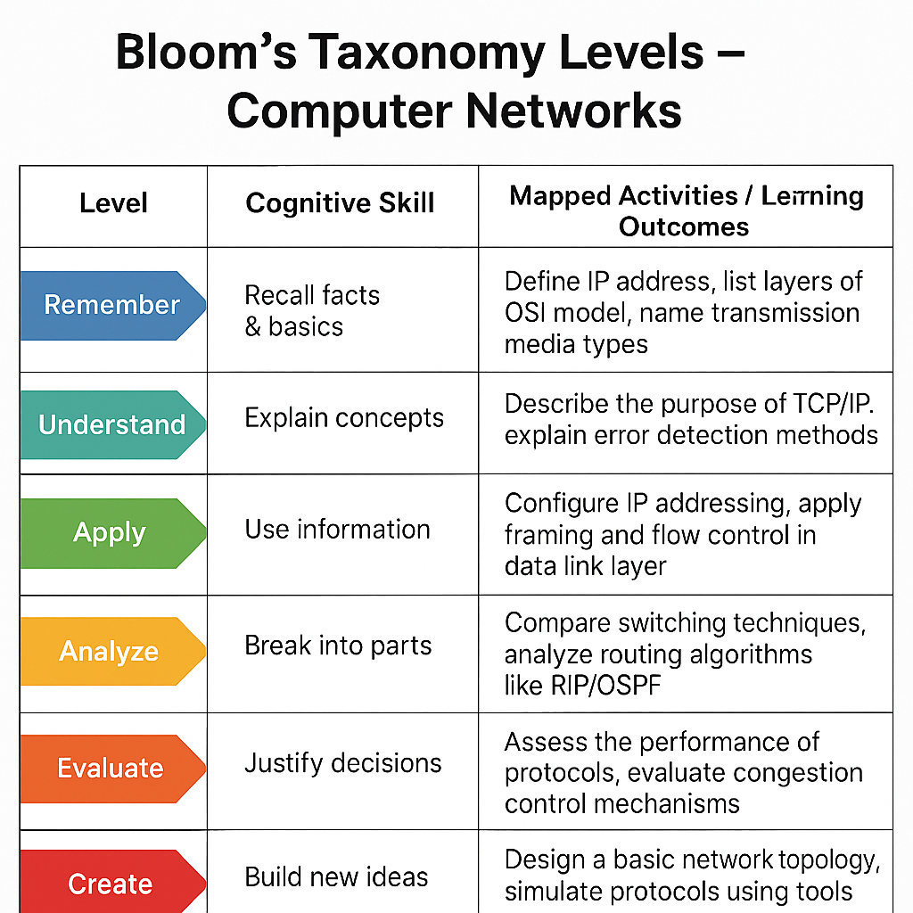
BLOOMS LEVEL
‹#›

Slide 14
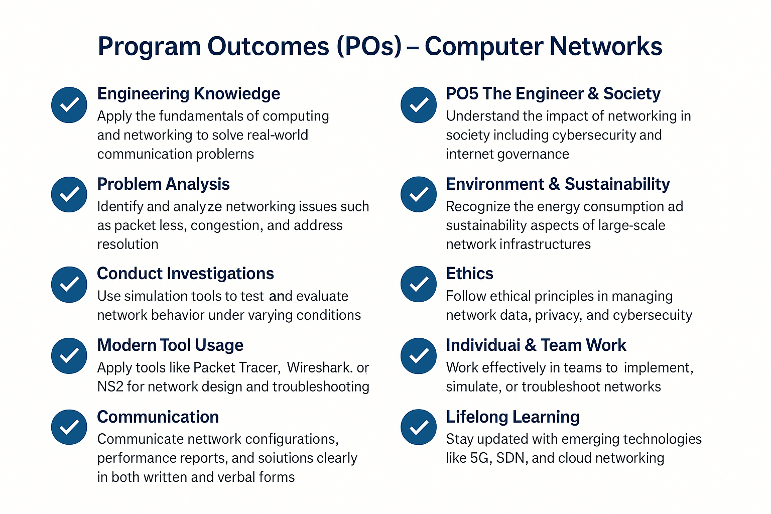
PROGRAM OUTCOMES
‹#›

Slide 15
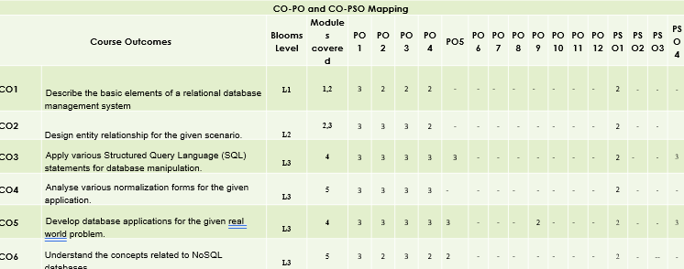
CO-PO MAPPING
‹#›

Slide 16
QUIZ-DAY 1
‹#›
What is a DBMS? a) A programming language b) Software to manage databases c) A type of computer hardware d) A network protocol
Which of the following is not a function of DBMS? a) Data storage b) Data retrieval c) Data visualization d) Data security
What is the main advantage of using a DBMS over a file system? a) Faster internet speed b) Reduced redundancy and improved consistency c) Less disk space d) Easier hardware installation
Which of these is an example of a DBMS? a) MySQL b) Microsoft Word c) Photoshop d) Notepad
Which of the following is a role directly responsible for maintaining databases? a) Data Scientist b) Database Administrator (DBA) c) System Analyst d) Data Engineer
A Data Analyst mainly works with: a) Database design only b) Extracting insights from data c) Hardware maintenance d) Writing operating systems
Which skill is part of the core competency acquired in a DBMS course? a) Designing ER models b) Painting and sketching c) Building computer hardware d) Operating system installation
Working knowledge of NoSQL databases helps students in: a) Real-time analytics and big data applications b) Hardware troubleshooting c) Writing basic Python programs d) Cloud networking

Slide 17

EXPECTATION SETTING OVERVIEW (DAY-2)
Subject: DBMS
Semester : V SEMESTER
Course Instructors: Prof. Abdul Kather
Assistant Professor
ISE Dept.
Notes:
‹#›

Slide 18
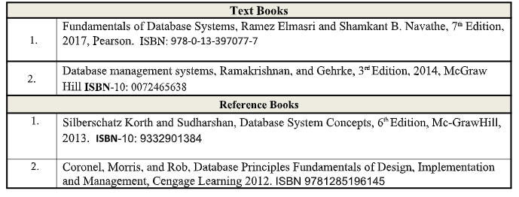
LEARNING RESOURCES AND REFERENCE BOOKS
‹#›

Slide 19
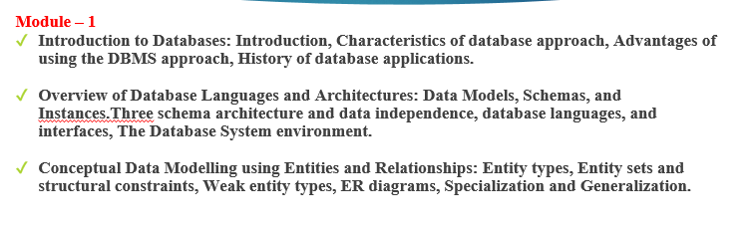
LESSON PLAN-MODULES
‹#›

Slide 20
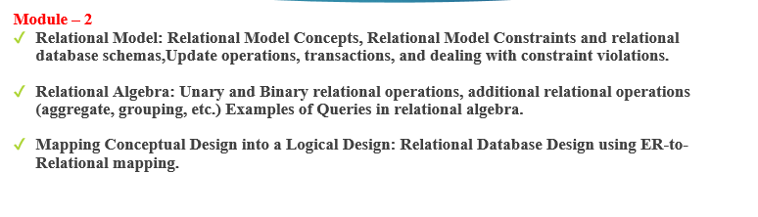
LESSON PLAN-MODULES
‹#›

Slide 21
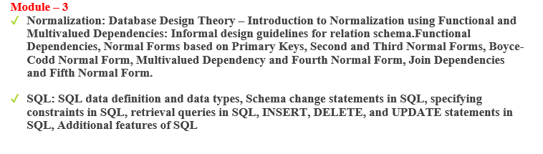
LESSON PLAN-MODULES
‹#›

Slide 22
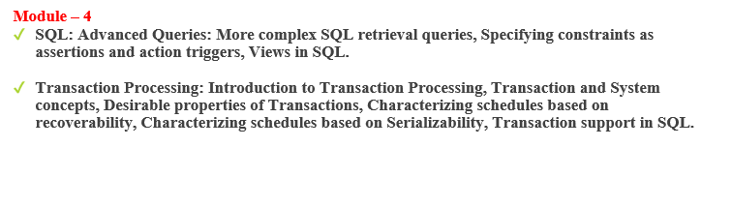
LESSON PLAN-MODULES
‹#›

Slide 23
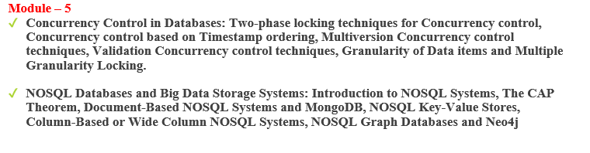
LESSON PLAN-MODULES
‹#›

Slide 24
ASSESSMENT PLAN
‹#›
IAT1 : unit 1,2 and 3
IAT2 : unit 4 and 5
Integerated Course: 50%(CIE) + 50%(SEE)
CIE:
IAT Theory (IAT1+IAT2)=15
Assignment1+Assignment2=10
Lab Continuous Evaluation=15
Lab Internal=10

Slide 25
EXPERIENCE FROM PREVIOUS BATCH STUDENTS
‹#›
Arya B - 1CR23IS002, Third Year , ISE
Akanksha Pandit - 1CR23IS008,Third Year , ISE

Slide 26



Expected classroom behaviour
‹#›
Active and Interactive Learning
Quizzes
Attendance: 85%
Hand written assignments (no plagiarism etc),
sticking to deadlines for submissions
no disruption
strict action against abusers

Slide 27
SOME USEFUL LINKS
‹#›
https://www.cs.uregina.ca/Links/class-info/215/erd/#:~:text=Data%20modeling%20is%20a%20technique,data%20requirements%20for%20a%20database
https://www.geeksforgeeks.org/generalization-specialization-and-aggregation-in-er-model/
https://www.guru99.com/relational-data-model-dbms.html
https://www.tutorialspoint.com/dbms/relational_algebra.htm

Slide 28
‹#›
Thank You

